Slide 1
Deep Learning based Alzheimer's Detection
By Rajath Rajesh (2021A1PS2117P)

Slide 2
Motivation
Alzheimer's Disease affects millions worldwide, causing memory loss and cognitive decline.
Early detection can significantly slow disease progression through timely intervention.
Manual diagnosis (MRI scans) is time-consuming and prone to human error.
Machine Learning (ML) can aid in automated, early, and accurate detection.

Slide 3

Datasets Used (OASIS)
OASIS-1 Dataset Distribution Overview
Total Subjects: 416 individuals
Age Range: 18 to 96 years
Diagnosis Breakdown:
Dementia (probable Alzheimer's disease): ~100 subjects
Non-Demented (healthy controls): ~316 subjects
Classes (based on CDR - Clinical Dementia Rating):
CDR 0: Healthy (no dementia)
CDR 0.5: Very Mild Dementia
CDR 1: Mild Dementia
CDR 2: Moderate Dementia
However, the most valuable class CDR 2 has only 2 entries

Slide 4

Dataset Used (ADNI)
ADNI MRI Dataset Distribution Overview
Total Subjects: 800+ (varies by ADNI phase; ADNI-1 has around 800 baseline MRIs)
Age Range: 55 to 90 years
Diagnosis Breakdown:
Alzheimer's Disease (AD): ~200 subjects
Mild Cognitive Impairment (MCI): ~400 subjects
Healthy Controls (HC): ~200 subjects
Classes (based on Clinical Diagnosis):
HC (Healthy Controls): No cognitive impairment
EMCI / LMCI: Early / Late Mild Cognitive Impairment
AD: Diagnosed Alzheimer's Disease
Typical Class Distribution in ADNI-1 (baseline):
Imaging Modality: Primarily T1-weighted MRI scans (3D MPRAGE sequences).

Slide 5
The Class Imbalance Issue and its fixes
Problem: More healthy subjects than Alzheimer’s patients in datasets.
Fixes Applied:
Class Weights: Assigned higher weight to minority class.
Focal Loss: Focused learning on harder-to-classify examples.
Data Augmentation: Created synthetic samples through transformations.

Slide 6
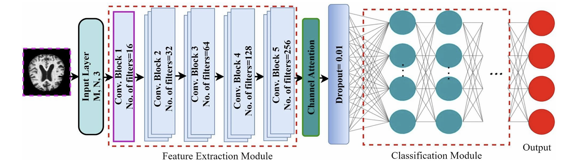
Models Used for OASIS Dataset
Attention Based CNN (Stacked CNN) with Class Weights

Slide 7
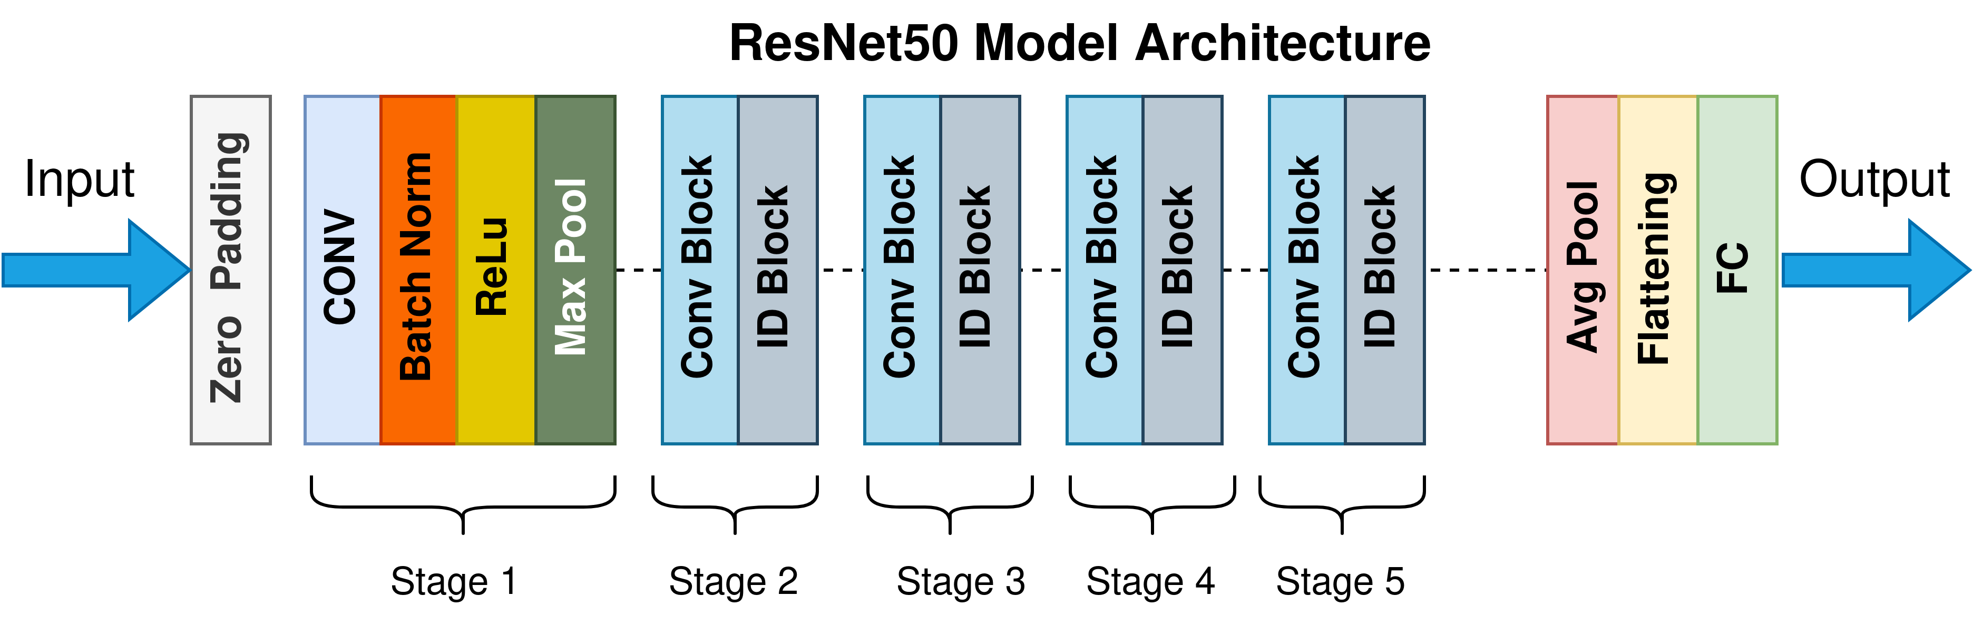
Models Used for OASIS Dataset
2) Resnet50

Slide 8
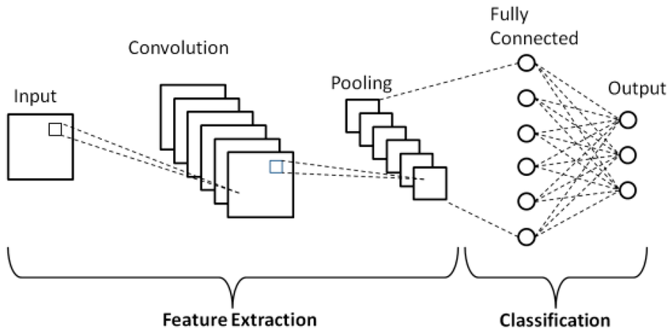
Models Used for OASIS Dataset
3) Basic CNN

Slide 9
Models Used for ADNI Dataset
1) Basic CNN

Slide 10
Results (OASIS)
For the OASIS dataset the best performing was the Stacked CNN architecture.
Metric | Value
Accuracy | 0.9931
Loss | 0.0246
Precision | 0.9937
Recall | 0.9925

Slide 11
Results (ADNI)
For the ADNI Dataset, the best performing model was the base CNN Architecture:
Metric | Value
Accuracy | 0.9138
Loss | 0.2125

